Slide 1
Keys
Unit2 _Day 6

Slide 2
General Guideline
© (2021) ABES Engineering College.
This document contains valuable confidential and proprietary information of ABESEC. Such confidential and proprietary information includes, amongst others, proprietary intellectual property which can be legally protected and commercialized. Such information is furnished herein for training purposes only. Except with the express prior written permission of ABESEC, this document and the information contained herein may not be published, disclosed, or used for any other purpose.

Slide 3
Chapter Objective
Describe use and apply data analysis and Modelling Techniques i.e. data modelling
To apply Binary Relationship Constraints
Describe the fundamental Elements of ER Model
To understand the concept of Keys
To Explain the Extended E- R concepts
Convert the ER model to relational table in populated relation database

Slide 4
Topics Covered
Day 2
Constraints on Binary Relationship Types
Day 3
Completion of ER model
Day 4
Reduction of an ER Model to an Relational Table (Cont.).
Day 1
Introduction Case Study-User Requirement
Basic Concept of ER Model
ER Modelling
Entities
Attributes
Relationship
Keys
Primary
Foreign key
Extended ER Concept
Reduction of an ER Model to an Relational Table
Complete Relational Model of Case Study

Slide 5
Constraints on Binary Relationship Types
Relationship types usually have certain constraints that limit the possible combination of entities that may participate in the corresponding relationship set.
These constraints are determined from the real-world situation that the relationships represent.
For example, a student can be part of exactly one department, and then we would like to describe this constraint in the database design.

Slide 6
Cardinality Ratio
The cardinality ratio expresses the number of entities to which another entity can be associated via a relationship set.
For a binary relationship type R between entity types A and B, the mapping cardinality must be one of the following:
One-to-one
One-to-many
Many-to-one
Many-to-many

Slide 7
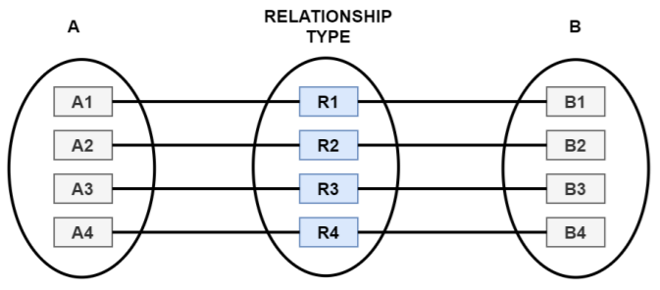

Cardinality Ratio (Cont.)
1) One-to-one. An entity in A is associated with at most one entity in B, and an entity in B is associated with at most one entity in A.
Representation of One-To-One Cardinality
Entity-relationship showing One-To-One Cardinality

Slide 8
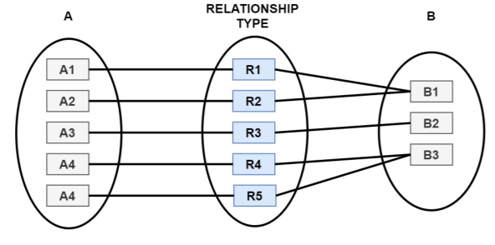

Cardinality Ratio (Cont.)
2) One-to-many. An entity in A is associated with any number (zero or more) of entities in B. An entity in B, however, can be associated with at most one entity in A.
Representation of One-To-Many Cardinality
Entity-relationship showing One-To-Many Cardinality

Slide 9
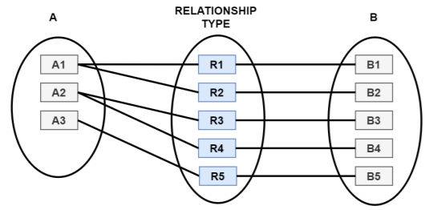

Cardinality Ratio (Cont.)
3) Many-to-one. An entity in A is associated with at most one entity in B. However, an entity in B can be associated with any number (zero or more) of entities in A.
Representation of Many-To-One Cardinality
Entity-relationship showing Many-To-One Cardinality

Slide 10
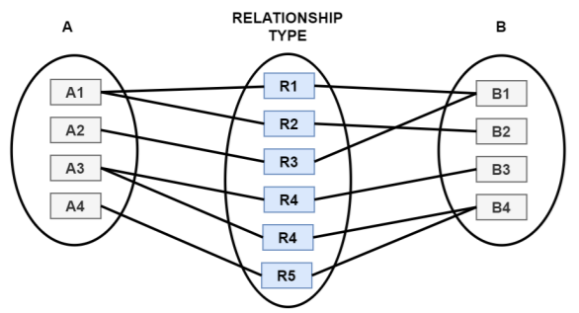

Cardinality Ratio (Cont.)
4) Many-to-many. An entity in A is associated with any number (zero or more) of entities in B, and an entity in B is associated with any number (zero or more) of entities in A.
Representation of Many-To-Many Cardinality
Entity-relationship showing Many-To-Many Cardinality

Slide 11
Can we answer?
An entity in A is associated with at most one entity in B, and an entity in B is associated with at most one entity in A.
One to many
One to One
Many to Many
Many to One

Slide 12
Limit on Cardinality Ratio
ER diagrams also provide a way to indicate more complex constraints on the number of times each entity participates in relationships in a relationship set.
An edge between an entity set and a binary relationship set can have an associated minimum and maximum cardinality.
This is shown in the form l..h, where l is the minimum and h the maximum cardinality.

Slide 13

Limit on Cardinality Ratio (Cont.)
Example: Faculty are supposed to work on research projects. One faculty can work on Zero or a maximum of three research projects. A research project can have a minimum of one and a maximum of any number of faculty members.
Entity-relationship showing Limits on Cardinality Ratio

Slide 14
Can we answer?
……………………. Is the restriction imposed to maintain data integrity of the database.
Mapping Cardinalities
Cardinality ration
Participation constraints
All of the above

Slide 15
Can we answer?
For Binary relationship set R between entity set A and B, the express number of entities to which another entities ca be associated.
Cardinality Ratio
Participation Constraints
Limited Ratio
Degree Ratio

Slide 16
Participation Constraints & Existence Dependencies
The participation of an entity set E in a relationship set R is said to be total if every entity instance in E participates in at least one relationship in R.
If only some entities in E participate in relationships in R, the participation of entity set E in relationship R is said to be partial.
Total participation is also called existence dependency.

Slide 17

Total and Partial Participation
In an ER diagram, total participation is shown by double lines, which indicates the total participation of an entity set in a relationship set & partial participation is shown by a single line which indicates the partial participation of an entity set in a relationship set.
Entity relationship showing partial (single line) and total participation (double lines)

Slide 18

Identifying relationship type
A weak entity type always has a total participation constraint (existence dependency) with respect to its identifying entity type because a weak entity type cannot exist without an owner (identifying) entity type.
The relationship associating the weak entity type with its identifying entity type is called the identifying relationship type. Identifying relationship type is shown by a double outlined diamond symbol.
Entity relationship showing identifying relationship (double outlined diamond)

Slide 19
Question
Let E be an entity set in a relationship set R. If every entity in E participates in at least one relationship in R, then participation of E in R is…………………
Partial
Total
Complete
Incomplete

Slide 20
Question
Total participation of an entity in a relationship set is represented using……….
Double line
Single line
Double rectangle
Dashed line

Slide 21
Question
How are roles specified in an ER diagram a) By labeling the rectangles b) By labeling the diamonds c) Roles cannot be specified in an ER diagram d) By labeling the lines

Slide 22
Question
State true or false: Every weak entity set must be associated with an identifying entity a) True b) False
State true or false: A weak entity can participate in all the relationships. a) True b) False

Slide 23


Explain following diagrams
a.
b.

Slide 24


Explain following diagrams
c.
d.

Slide 25
Session 2:- Introduction to Keys
Topics to be covered
Keys
Primary
Foreign key
Extended ER diagram

Slide 26
Keys
A key is an attribute or a set of attributes of an entity type that help to uniquely identify an entity instance in an entity set and is also used to establish relationships between the different entity types.
Two important types of keys are discussed here.
Primary Key
Composite Primary Key
Foreign Key

Slide 27
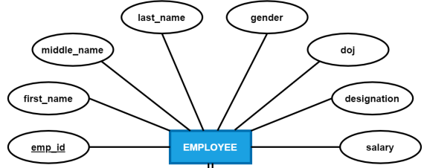
Primary Key
A Table column(s) with the following set of features can be designated as the primary key. A Table can have one and only one primary key.
Its value can never be NULL.
Its value is always unique for each instance.
The value once provided cannot be changed
Or become NULL during lifetime of entity.
In given diagram emp_id is
Primary Key

Slide 28
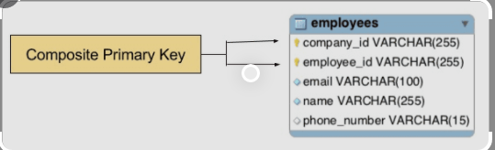
Composite Primary Key
In case a table does not have a single table column that can identify table rows uniquely, we have to combine two or more table columns to make the key.
This combination of two or more table columns that can be used to identify table rows uniquely is called the composite key or composite primary key.
Note: A table can have only one Primary key .

Slide 29
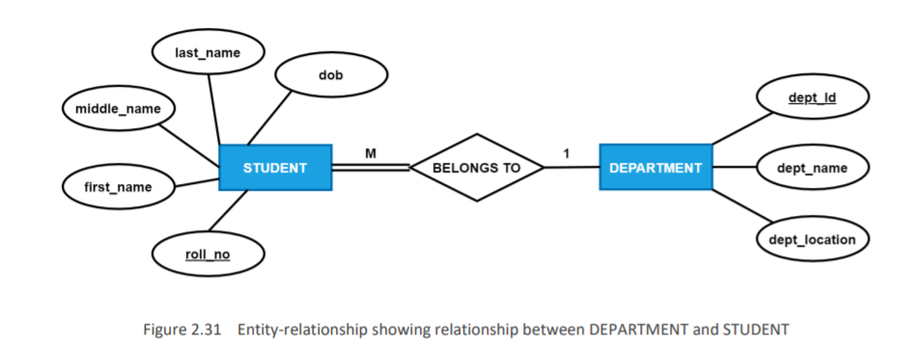
Foreign Key
A primary key of a Table is called a foreign key to some other Table when that column is used to relate the two Tables.

Slide 30
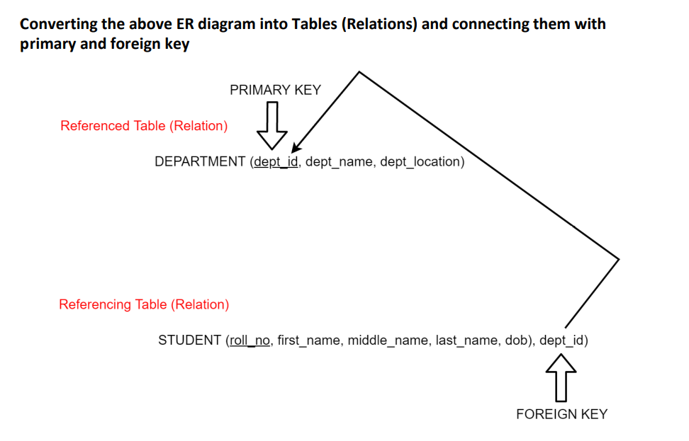
Foreign Key

Slide 31
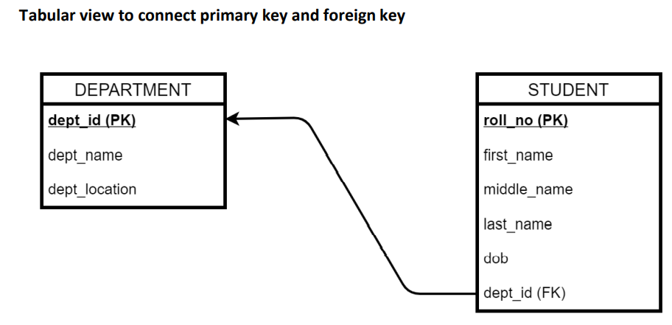
Foreign Key

Slide 32
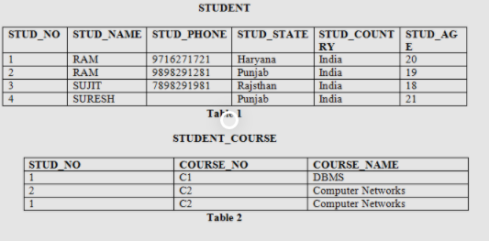
Question
Identify primary key and foreign keys?

Slide 33
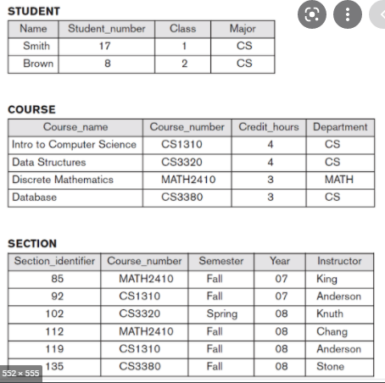
Identify primary key and foreign keys?

Slide 34
Identify primary key and foreign keys?
Q1:
Students( id, name)
Grades ( Student_id, grades, course_id)
Course (id, name).
Q2:
Customers (Cust_id, cust_name, Cust_street, Cust_city, Cust_pincode)
Orders (Order_no, customer_id, order_date, ship_date, emp_no )
Employee (Employee_no, name, position, hourly_rate)

Slide 35
Questions!!!!!!
A Key which is a set of one or more columns that can identify a record uniquely is called? a) Natural key b) Candidate key c) Not Null key d) Alternate key
Which key accepts multiple NULL values? a) Foreign Key b) Unique Key c) Primary Key d) None of the Mentioned

Slide 36
Extended ER Diagram / Enhanced ER diagram (EER)
Is needed to design accurate database schemas that reflect data properties and constraints more precisely.
Applications: CAD/CAM, Telecommunications, GIS etc…
This lead to the development of additional semantic data modelling concepts which is incorporated in conceptual data models termed as EER ( Extended ER ). It includes the following concepts:
Specialization/Generalization
Attribute Inheritance
Constraints on Specialization/Generalization.

Slide 37
Specialization and Generalization
Specialization An entity type may include subgroupings of distinct entities in some way from other entities in the set.
Generalization The refinement from an initial entity type into successive levels of entity subgroupings represents a top-down design process in which distinctions are made explicit.

Slide 38
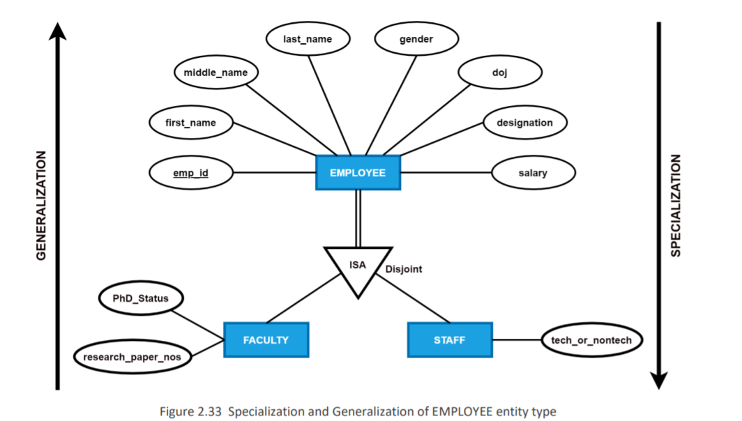
Specialization and Generalization

Slide 39
Attribute Inheritance
A crucial property of the higher and lower-level entities created by specialization and generalization is attribute inheritance.
The attributes of the higher-level entity types are said to be inherited by the lower-level entity types.

Slide 40
Constraints on generalization
There are certain constraints that database designers choose to put on a particular generalization.
Condition-defined: In condition-defined constraints lower-level entity types, membership is evaluated based on whether or not an entity satisfies an explicit condition or predicate.
User-defined: User-defined lower-level entity types are not constrained by a membership condition; rather, the database user assigns entities to a given entity type.

Slide 41
Constraints on generalization
The second type of constraint relates to whether or not entities may belong to more than one lower-level entity type within a single generalization
Disjoint: A disjointness constraint requires that an entity belongs to no more than one lower-level entity type. In our example, an EMPLOYEE entity can satisfy only one condition; an entity can be either a faculty or a staff, but cannot be both.
Overlapping: In overlapping generalizations, the same entity may belong to more than one lower-level entity type within a single generalization.

Slide 42
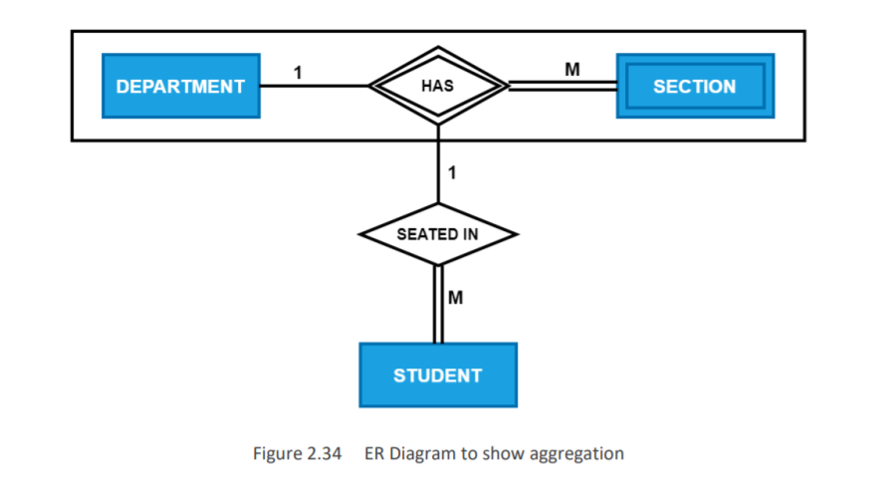
Aggregation
Aggregation is an abstraction through which relationships with its corresponding entities are aggregated into a higher-level entity.

Slide 43
Can we answer?
Which of the following is the specialization that permits multiple sets?
Superclass specialization
Disjoint specialization
Overlapping specialization
None

Slide 44
Can we answer?
The similarities between the entity set can be expressed by which of the following features?
Specialization
Generalization
Uniquation
Inheritance

Slide 45
Question
………………………..is an abstraction through which relationships are treated as higher level entities.
Creation
Superseding
Attribute separation
Aggregation

Slide 46
Question
Consider representation of specialization and generalization, the blank triangle is used to indicate the specific constraint called:
Disjoint node
Shared base constraint
Schema construct
Disjoint constraint

Slide 47
Thank You

